Slide 1


TIC TAC TOE
INDIVIDUAL PYTHON PROJECT
MADE BY :
SAMARTH PRAJAPATI
BRANCH ~ CSE
BATCH ~ 5
ROLL NUMBER ~ 155
ENROLLMENT ~ 22002171210137

Slide 2
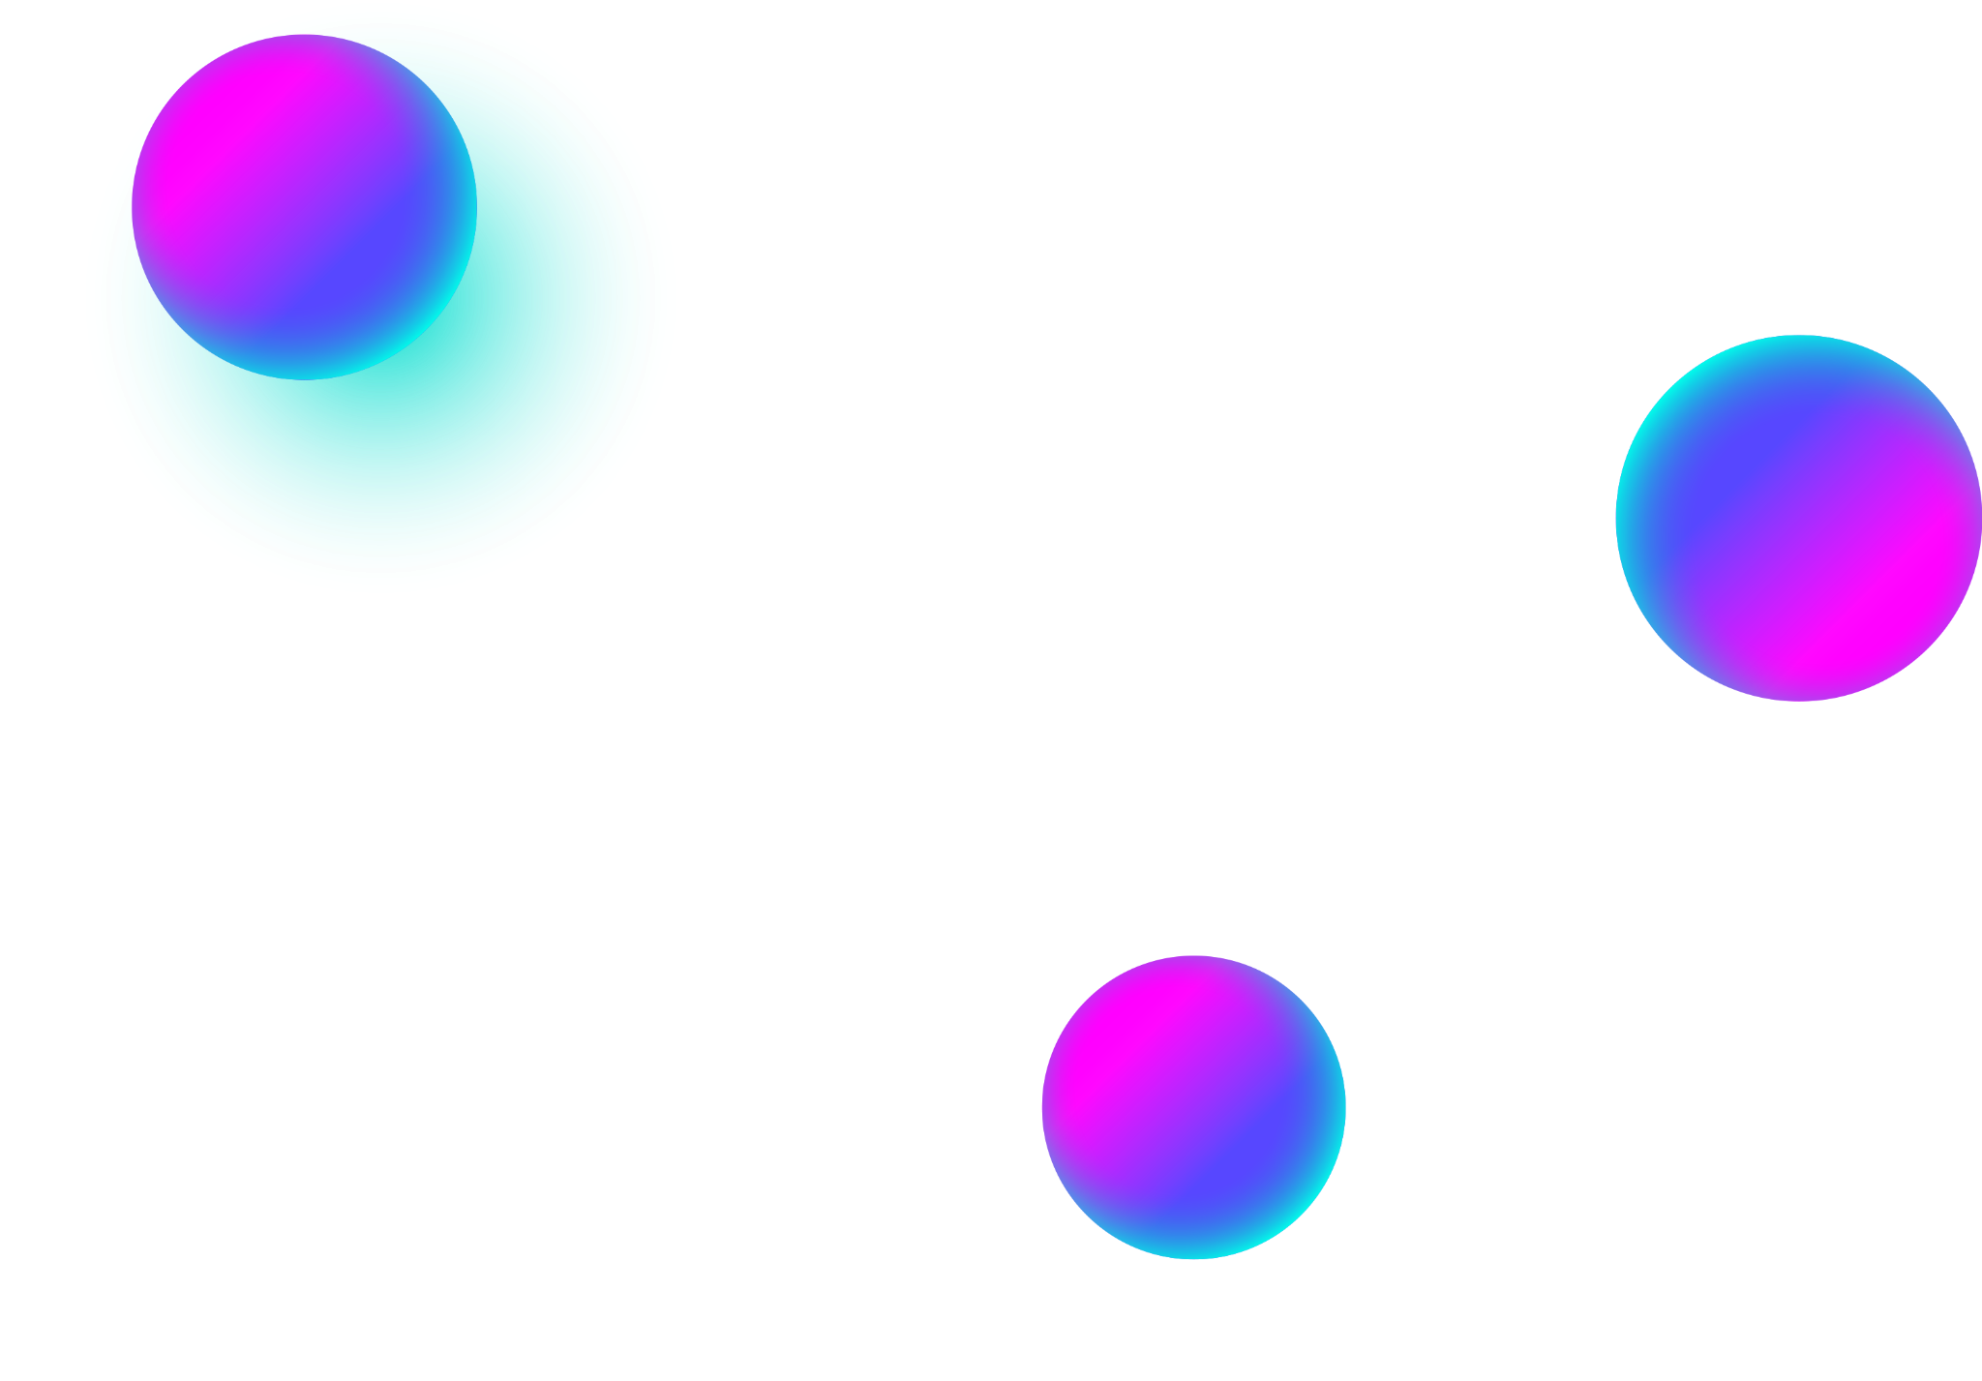
INTRODUCTION
Creating a Tic Tac Toe game using a graphical user interface (GUI) in Python can be accomplished using the Tkinter library, which is a built-in module for creating simple GUI applications.

Slide 3
FUNCTIONALITY
01
03
05
Graphical Interface
Grid Display
Player Interaction
02
04
06
Turn Management
Draw Detection
Game Reset
The game is presented visually using a GUI library such as Tkinter, Pygame, or PyQt.
The game board is displayed as a grid, usually consisting of 3 rows and 3 columns.
Players can interact with the game by clicking on the grid squares to place their X's or O's.
The game alternates between players for each turn, allowing them to place their respective symbols on the board.
If all the grid squares are filled and there is no winner, the game is declared a draw.
After a win or draw, the game board is cleared, and the players can start a new game.

Slide 4
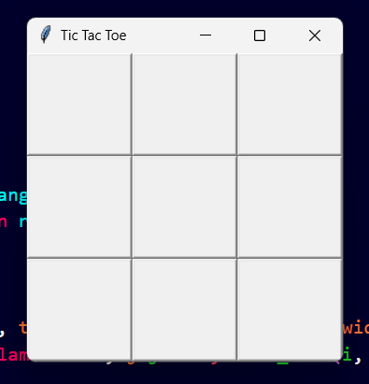
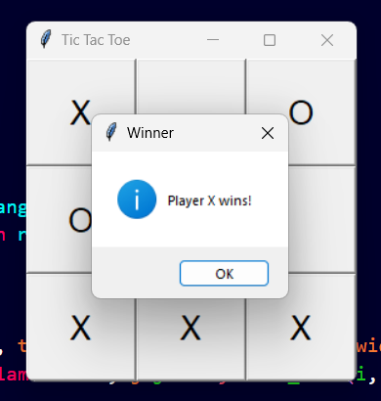
OUTPUT

Slide 5
THANK YOU

